Slide 1
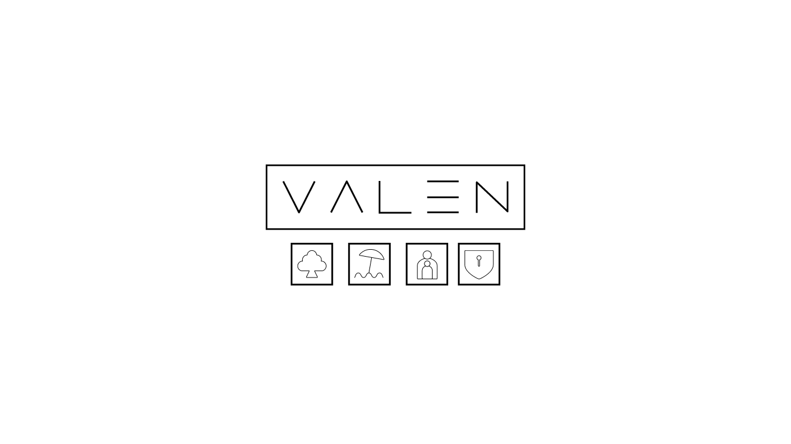
Wireframe diagrams to illustrate UXP
Users, within both VALEN for Families & VALEN for Partners platforms interact visually through a 3D heliocentric system
VALEN is the central entity around which users activate functional clusters and their related operational satellites
The heliocentric system functionality is universal to the entire VALEN UXP, used for both data retrieval and presented within VALEN’s needs-based philosophy through numerous sub-portals, including V Reports, or data entry through a Needscoping sub-portal.

Slide 2
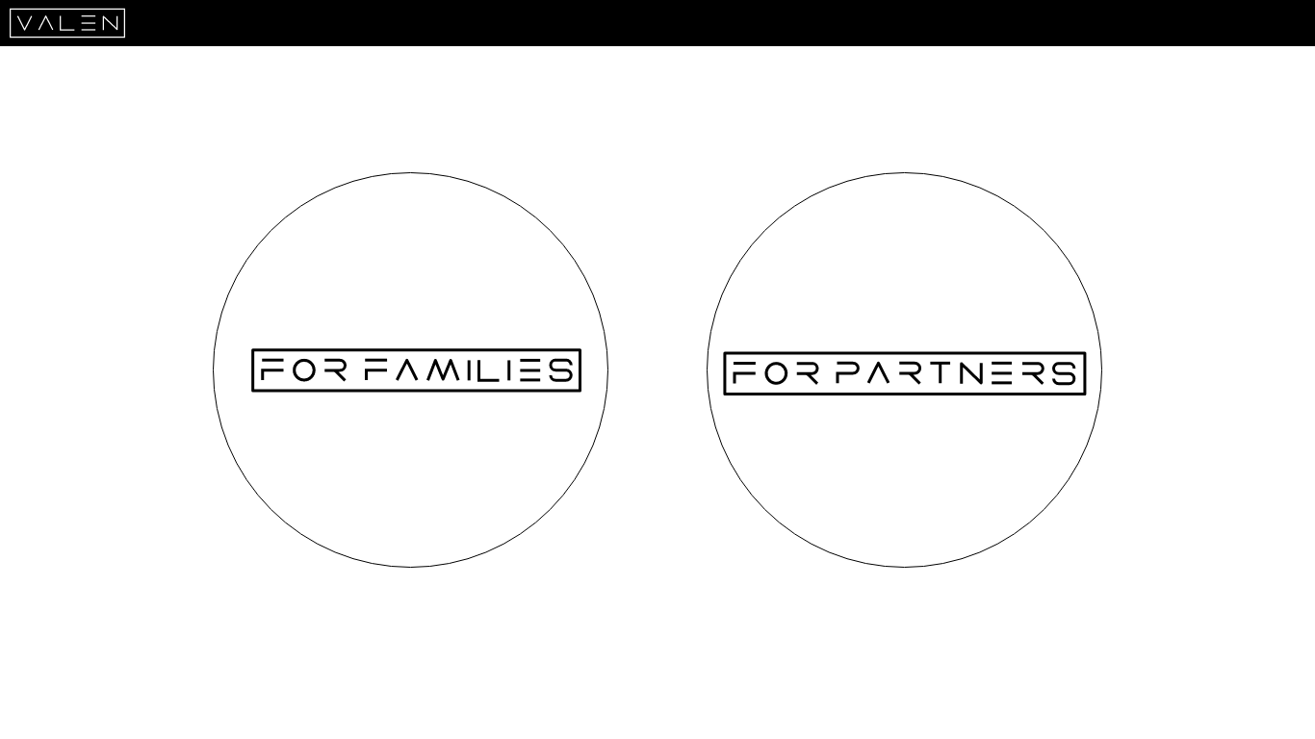

Slide 3
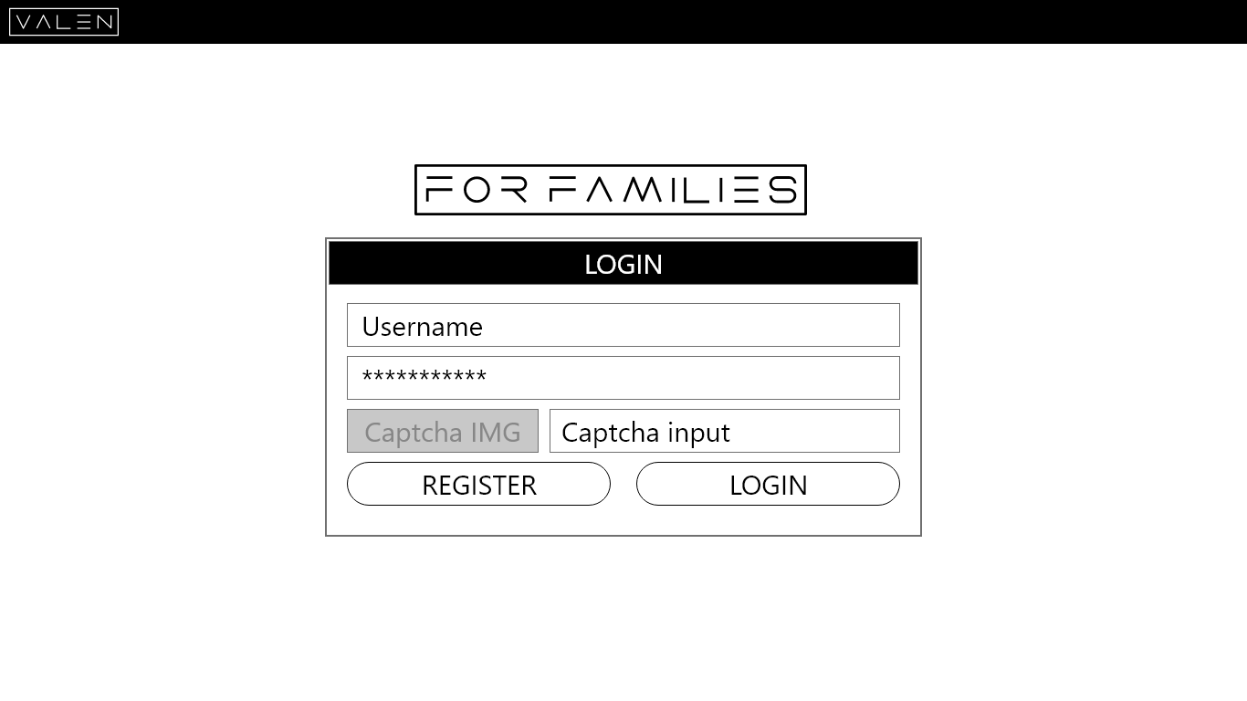

Slide 4
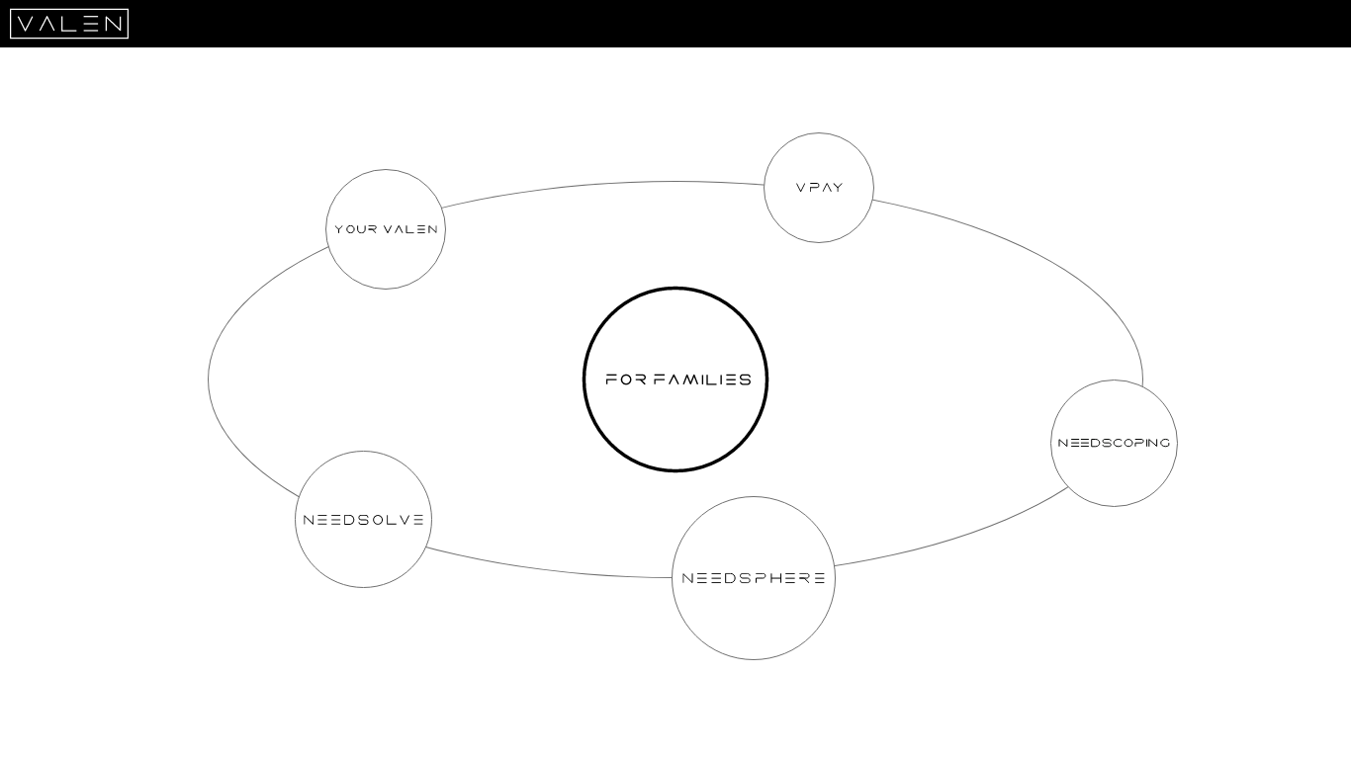

Slide 5
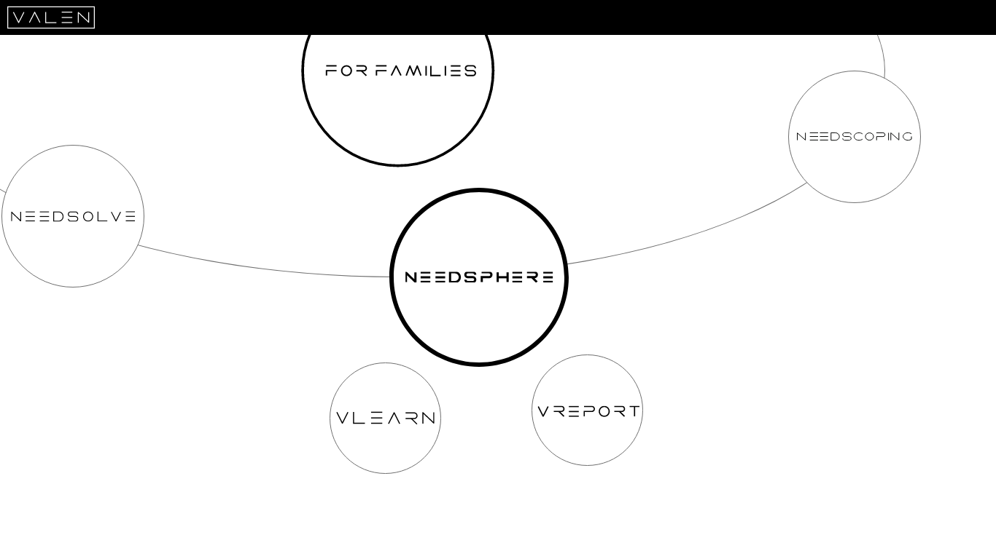

Slide 6
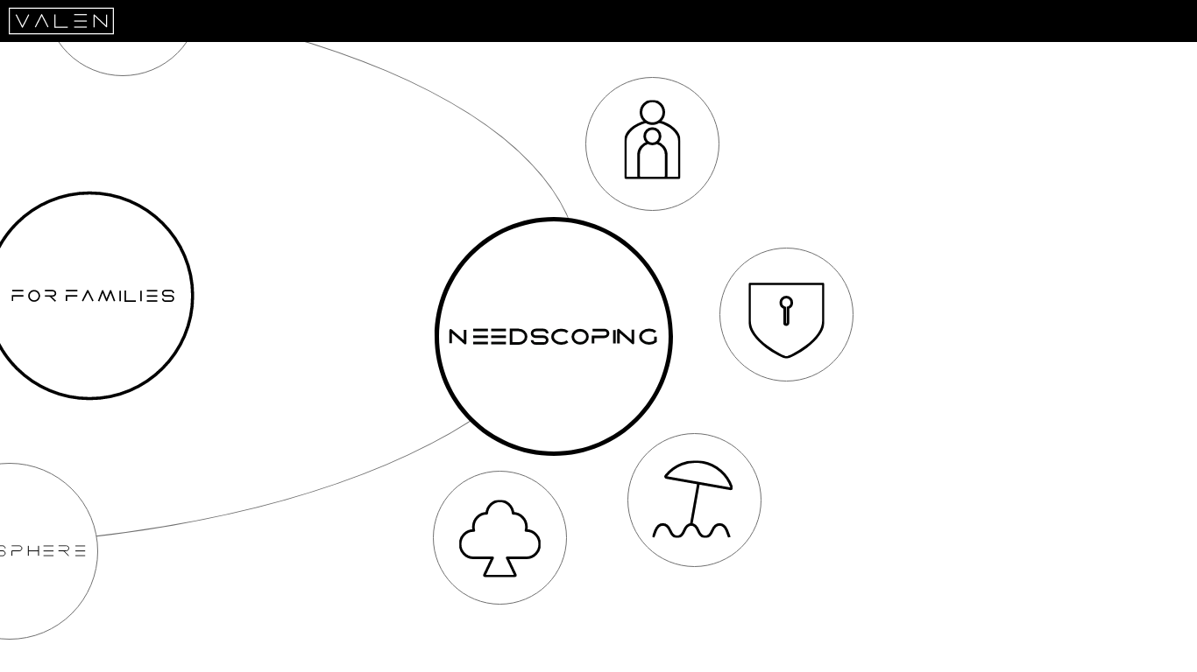

Slide 8
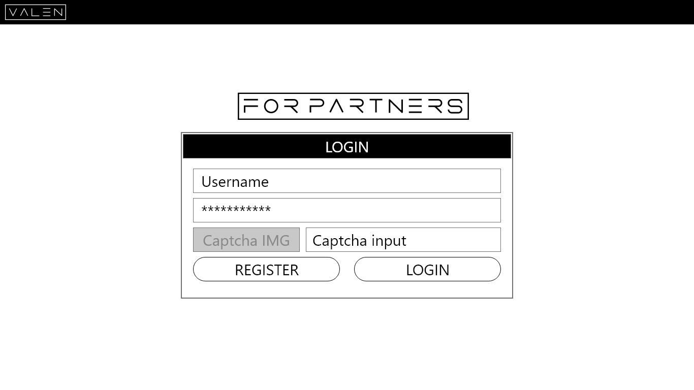

Slide 9
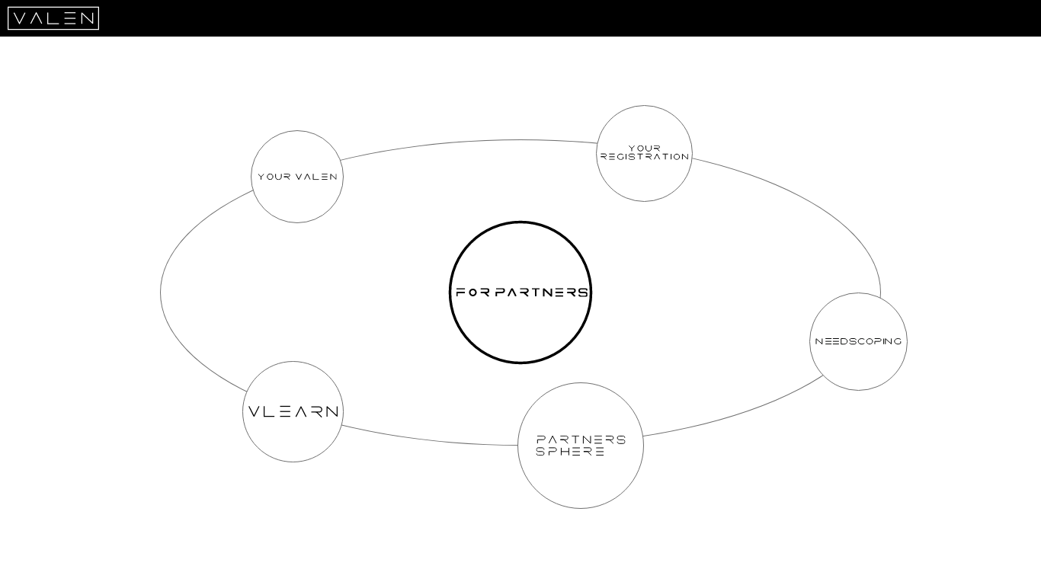

Slide 10
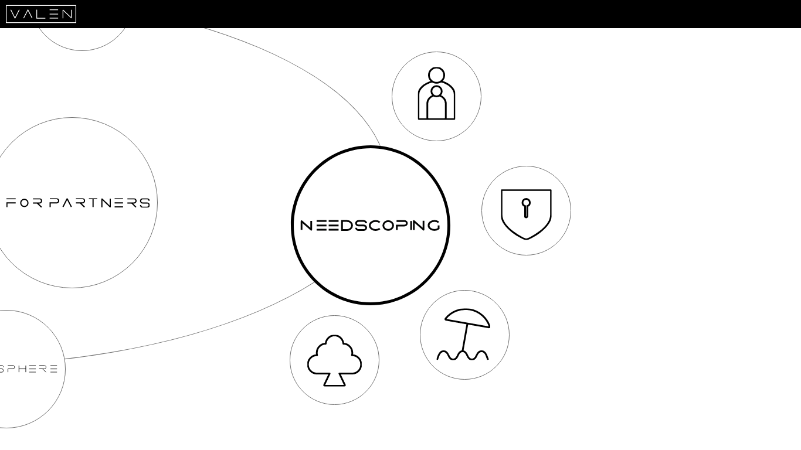

Slide 11
